Slide 1
Welcome!
2022 Summer learning series
This training is partially funded with a grant from the Minnesota Department of Education using federal funding, CFDA 84.287, 21st Century Community Learning Centers. This program does not necessarily represent the policy of the federal or state government and you should not assume endorsement.

Slide 2
Icebreaker
Answer the icebreaker questions in the chat!
Would you rather…
1. Be able to breathe underwater or fly?
2. Be able to speak any language or be able to communicate with animals?
3
4
5
6

Slide 4
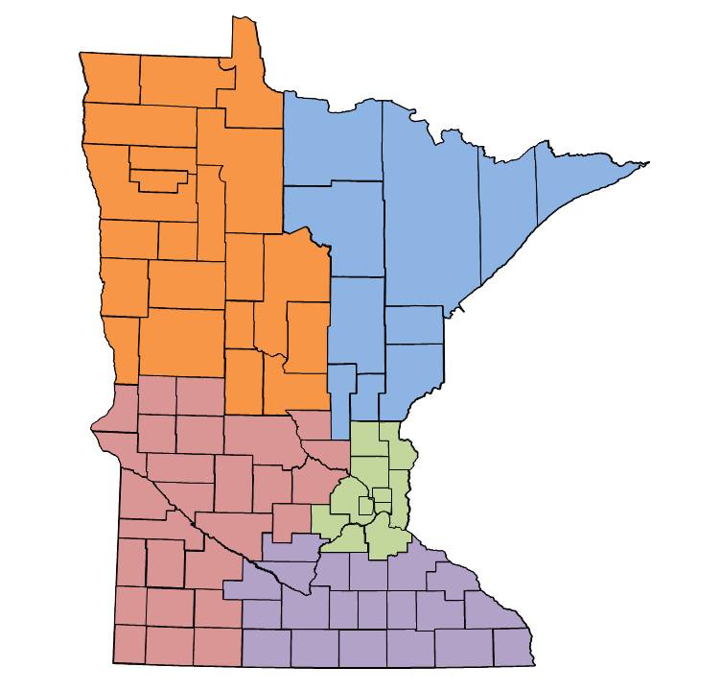
Who is Ignite Afterschool?
Promoting access to quality afterschool through:
Policy
Quality
Partnerships

Slide 5
Agenda for Today
Recap of last session
Asset and partnership mapping
Program design and content examples
Panel of summer program leaders
Breakout rooms
Time for questions

Slide 6
Effective Practices Review
Fun! (Engagement in Learning)
Create a positive climate and culture for young people and staff
Create culturally aware and responsive environment where young people and staff feel safe, appreciated, and supported
Programming should focus on BOTH academic supports* and enrichment activities (*3 hours for students most needing additional support)
Invest in and focus on social-emotional learning
Partner, partner, partner!
Provide transportation and meals
Commit to small class sizes (15) with a targeted population of young people
Create a program with plenty of opportunities to attend (programs that met 4-5 days a week for at least 5-6 weeks were most effective)
Build in time for professional development & staff reflection
Early planning is crucial – start now!

Slide 7
Diving into Partnerships
Asset mapping
What do you already have at your disposal? (Staff, curriculum, supplies, etc.)
What do you need?
Resource mapping
What funding do you already have in place?
Where could you use more financial support?
Staffing capacity—do you have enough staff, where would you need more support?
Partnership mapping
Who is in your community?

Slide 8
Partnerships 101
How do you create partnerships, what have people already done?
Who to build relationships with:
Schools and school districts- Engaging with principals, teacher’s unions, support staff, and district staff early on can help facilitate partnerships that last throughout the summer. This can also include charters, alternative and private schools.
Partnerships can also look like recruiting parents, teaching artists, paraprofessionals, high school students
Partner with each other! Do you know of a great, high-quality afterschool program that doesn’t have a summer component? Partner with those programs to continue to support young people over the summer and recruit staff from those programs for a summer position
Have a community partner brainstorm session where a variety of community partners are brought to the table to hear the mission/needs and brainstorm what they can bring to the table.
From The Wallace Foundation Sustainable Summer Program Planning Toolkit, Summer Learning and Enrichment Collaborative

Slide 9
Partnership Ideas
Statewide & Regional Systems such as:
County/city library system
4H statewide system (connected to county)
State and regional arts board (teaching artists)
Colleges, Universities, Community/Technical
Nationally Affiliated Nonprofits such as:
YMCA
YWCA
Future Farmers of America
Scouting
Boys and Girls Club
Business & Civic groups such as:
Local Chamber of Commerce or small business council
Elks/Kiwanis
Other organizations & ideas:
Sporting organizations like Ducks Unlimited
Animal Humane Society
Seniors & retiree groups

Slide 10
Program Design 101
In the chat share- how have you gathered input from young people in the past?
Things to Remember:
Be creative
Not every design will work in every context
It’s okay for your template to be a starting place but not necessarily your ending place!
Remember that there are ways you can work with curriculum and instruction to take content and align it with “standards” in a fun and engaging way.
Questions to ask yourself when designing curriculum are:
Is your content engaging and project based?
Do you have an opportunity to integrate service learning?
Are you listening to youth voice and needs?
From: Beyond the Bell, Boston YMCA from Wallace Foundation Summer Toolkit

Slide 11
Panel Discussion
Panelists:
Nikki Bye (Beacons Network)
Emmanuel Donaby (St. Paul City School)
Josh Reimnitz (Breakthrough Twin Cities)
Zong Vue (Ignite Afterschool/Sprokets)

Slide 12
Breakout Rooms
Teach and Learn:
What is one success you've had in summer program design to share or teach and what is one thing you'd like to learn or gather ideas about from others?

Slide 13
Wrapping Up and Reminders!
Our last session is on February 28th from 1:00-2:30pm
Feel free to reach out with any questions or things you’d like to share!
Contact information:
Kari Denissen Cunnien: kari@igniteafterschool.org
Sarah Loepfe: sarah@igniteafterschool.org

Slide 14
Resources
Beyond the Bell Toolkit. Tool 42: Summer Program Schedule. https://drive.google.com/file/d/1JEfc4CtaBsyNSR-NhuLzREawhbszH4Zj/view?usp=sharing
Summer Learning and Enrichment Collaborative. Working Together: Recruiting, Training, and Supporting Staff Members for Impactful Summer Learning. 2021. https://www.youtube.com/watch?v=tdTtqN-Zifc
Summer Learning Toolkit. The Wallace Foundation, 2021. https://www.wallacefoundation.org/knowledge-center/summer-learning/toolkit/pages/default.aspx

